Slide 1
Why Spring boot?

Slide 2
Spring boot features:
Dependency resolution
Auto configuration
Spring Boot Initializer
Starter POMs
Embedded server
Spring Boot CLI
Actuator

Slide 3
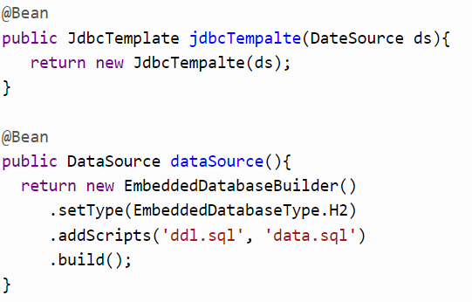
Auto Configuration
Spring application that uses Java-based configuration, you need to add the following two methods into your Configuration class:

Slide 4
Starter POMs
For a simple Spring MVC-based REST application that supports Jackson and to run it an embedded container, you would at least need the following dependencies:
spring-core.jar
spring-web.jar
spring-webmvc.jar
jackson-databind.jar
tomcat-embed-core.jar
tomcat-embed-el.jar
tomcat-embed-logging-juil.jar

Slide 5
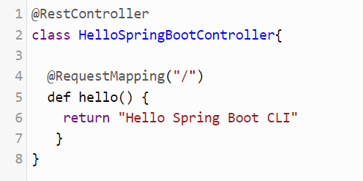
Spring Boot CLI
Simple HelloWorld RESTful Web Service in Groovy and Spring Boot CLI, and it works so that you can run it without compiling, as shown below:

